Slide 1
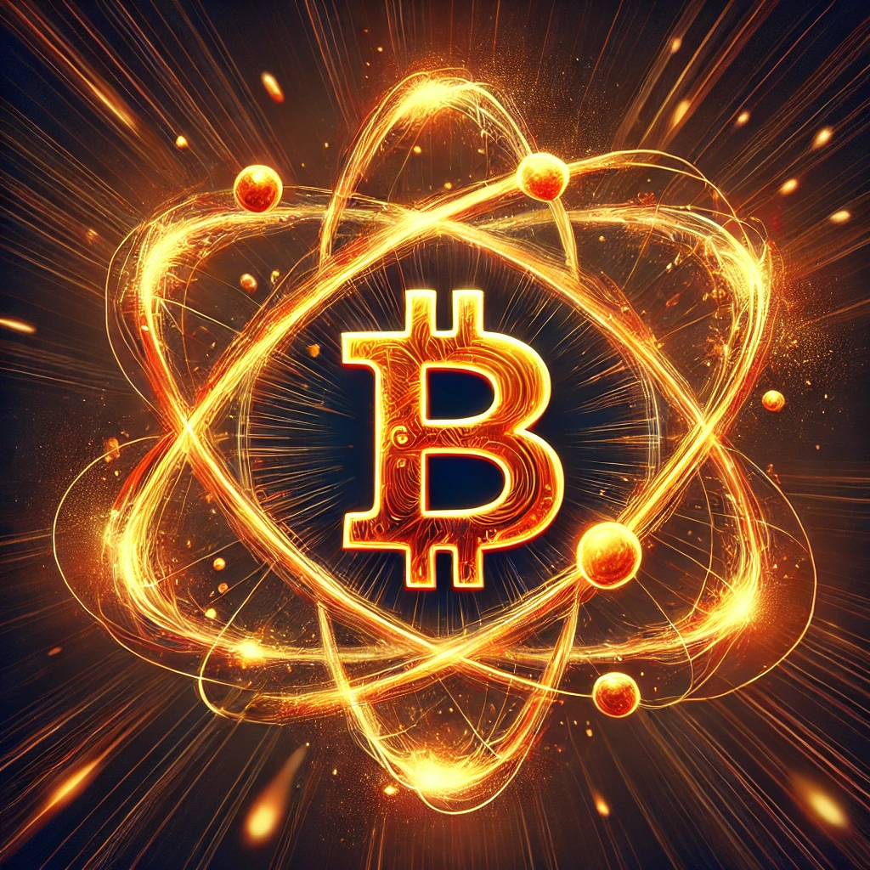
Bitcoin Quantum Security

Slide 2
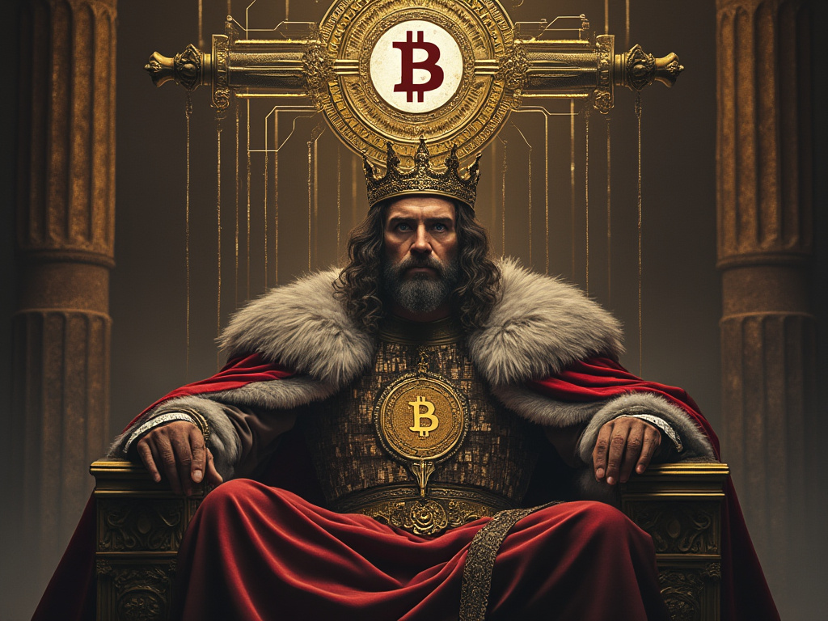
How does quantum computing pose a risk to bitcoin?

Slide 3

Mining
- SHA-256
- Grover’s

Slide 4
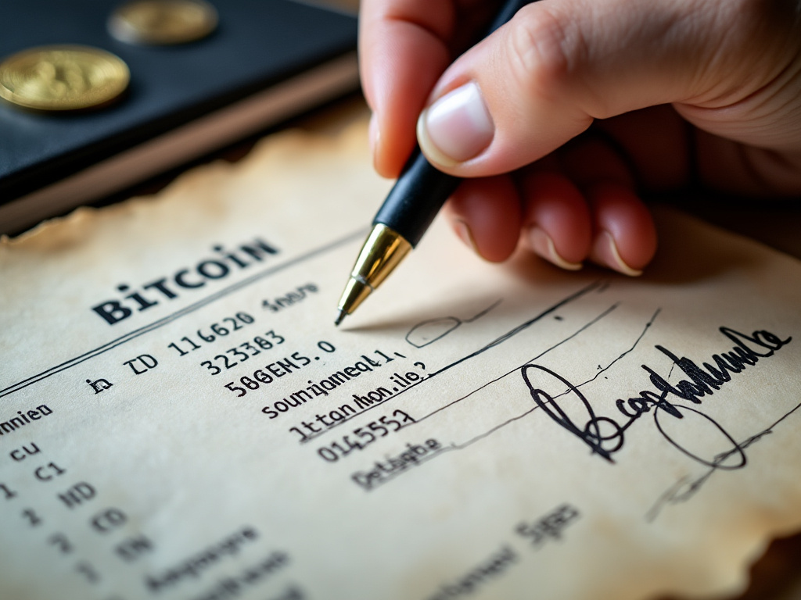
Signatures
- secp256k1
- Shor’s

Slide 5
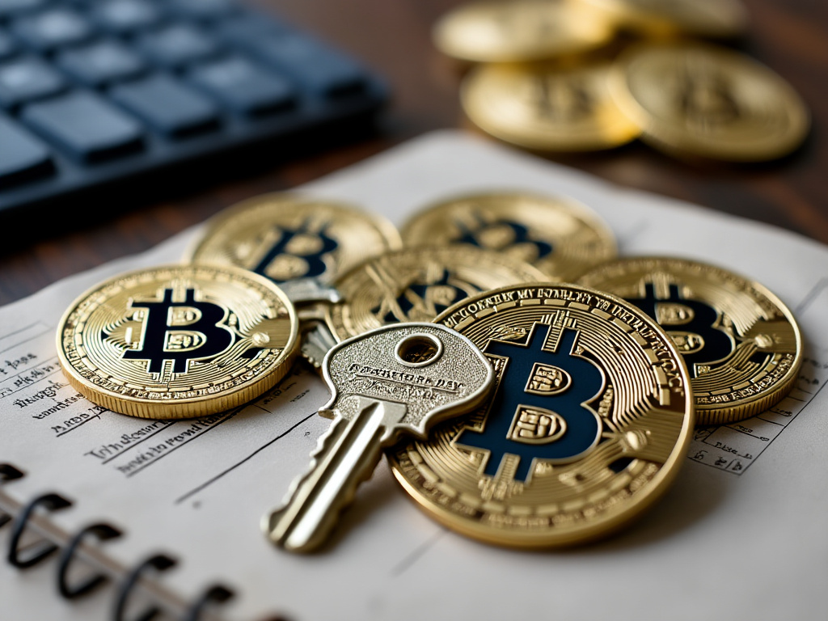
What makes coins vulnerable?
Exposed Public Keys.

Slide 6
When are public keys exposed?
1. Early addresses...
Satoshi’s coins,
CPU miners (04)

Slide 7
When are public keys exposed?
1. Early addresses...
Satoshi’s coins,
CPU miners (04)
2. Reused addresses
(any type)

Slide 8
When are public keys exposed?
1. Early addresses...
Satoshi’s coins,
CPU miners (04)
2. Reused addresses
(any type)
3. Taproot addresses
(bc1p)

Slide 9
When are public keys exposed?
1. Early addresses...
Satoshi’s coins,
CPU miners (04)
2. Reused addresses
(any type)
3. Taproot addresses
(bc1p)
4. Mempool transactions
(all except bc1r)

Slide 10
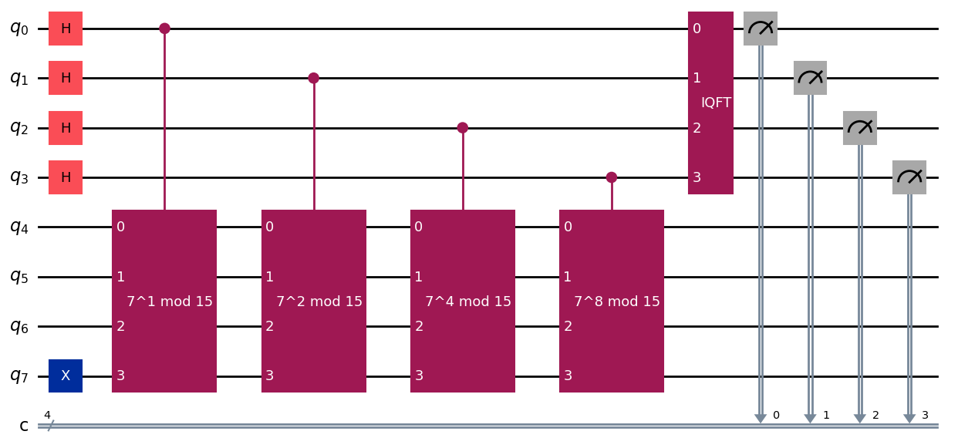
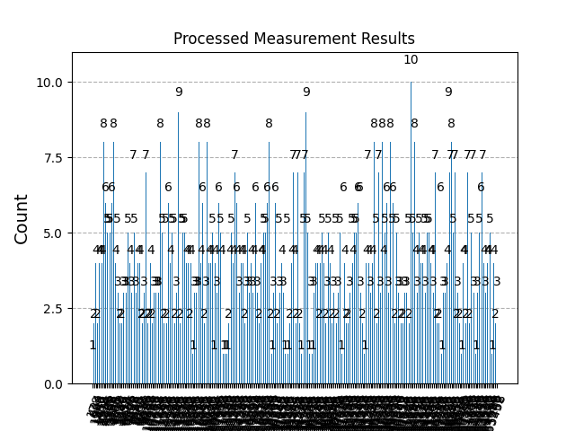
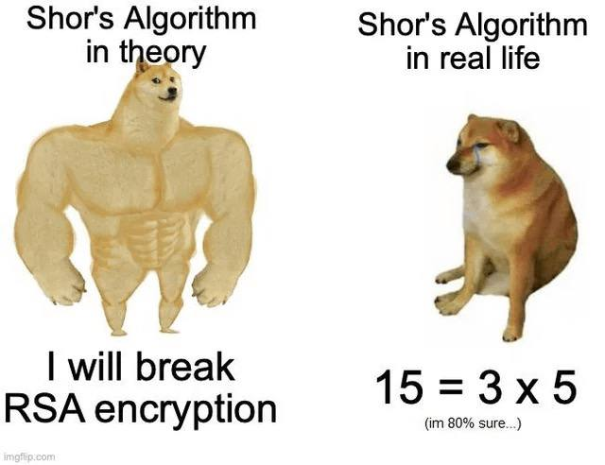
Shor’s algorithm

Slide 11
How soon?
4
Vendors
3
Scale
In addition to IBM, Rigetti, IonQ, and Atom Computing make suitable systems
2
Processor
Multiple systems can be connected to achieve up to 16,632 qubits
1
Hardware
IBM Heron:
133 qubit system
Gate Error: 0.1-0.3%
Crosstalk: Almost zero
Gate time: 90-100ns
IBM Quantum System Two:
Hardware is commercially available right now

Slide 12
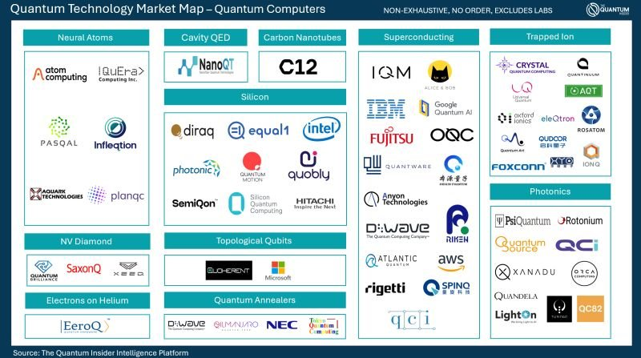

Slide 13
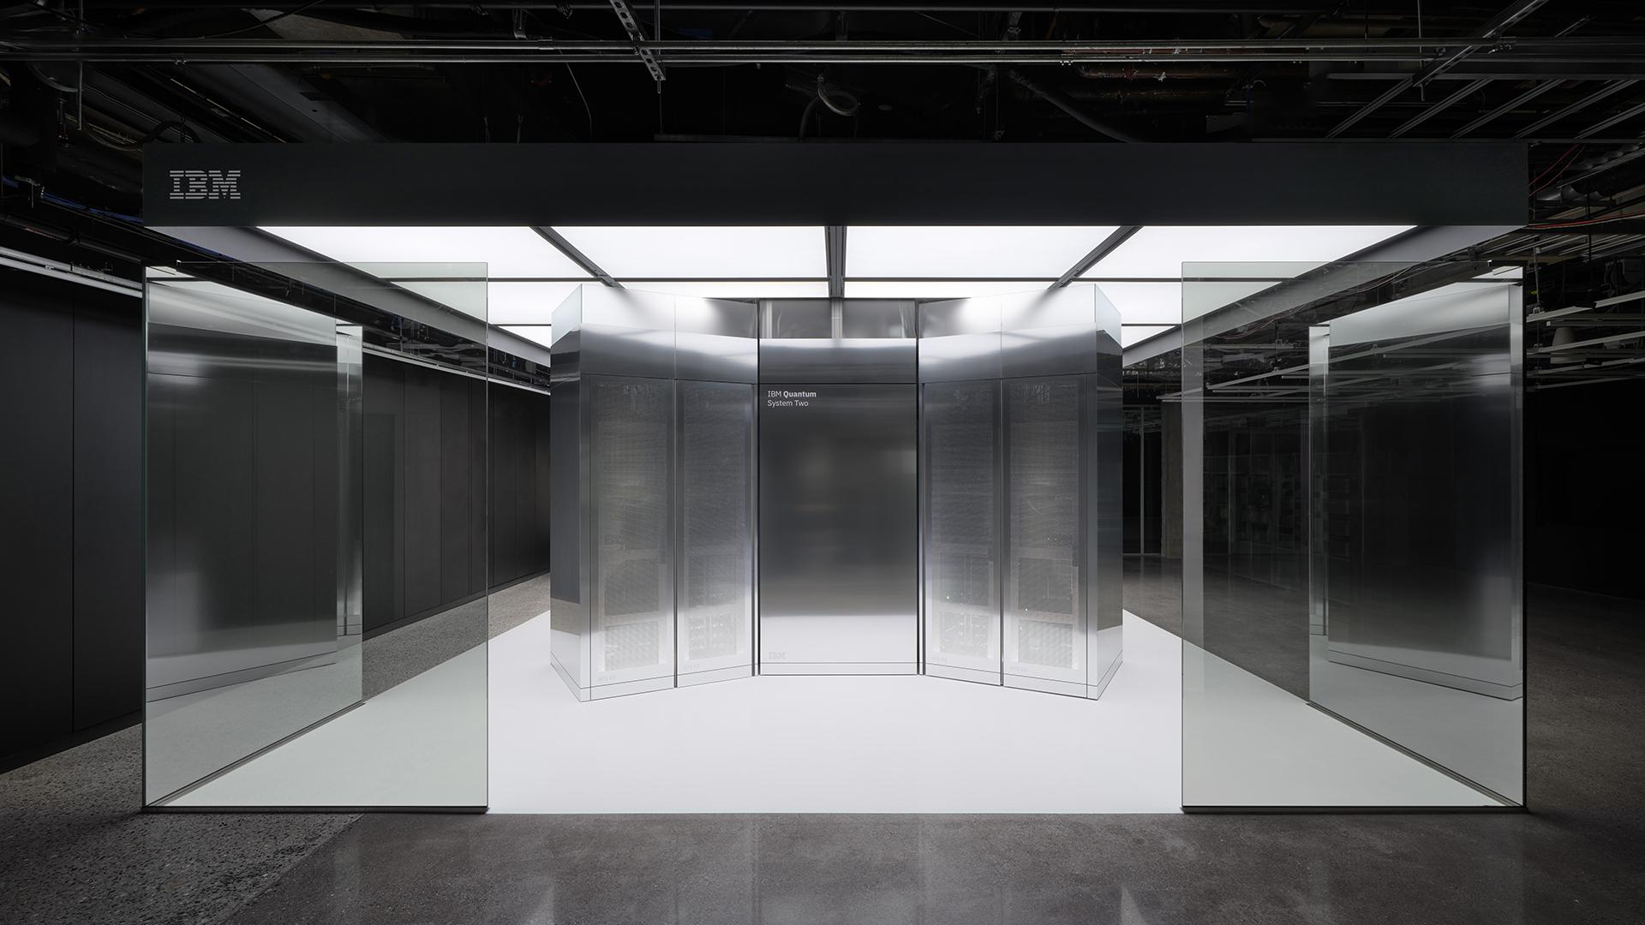

Slide 14
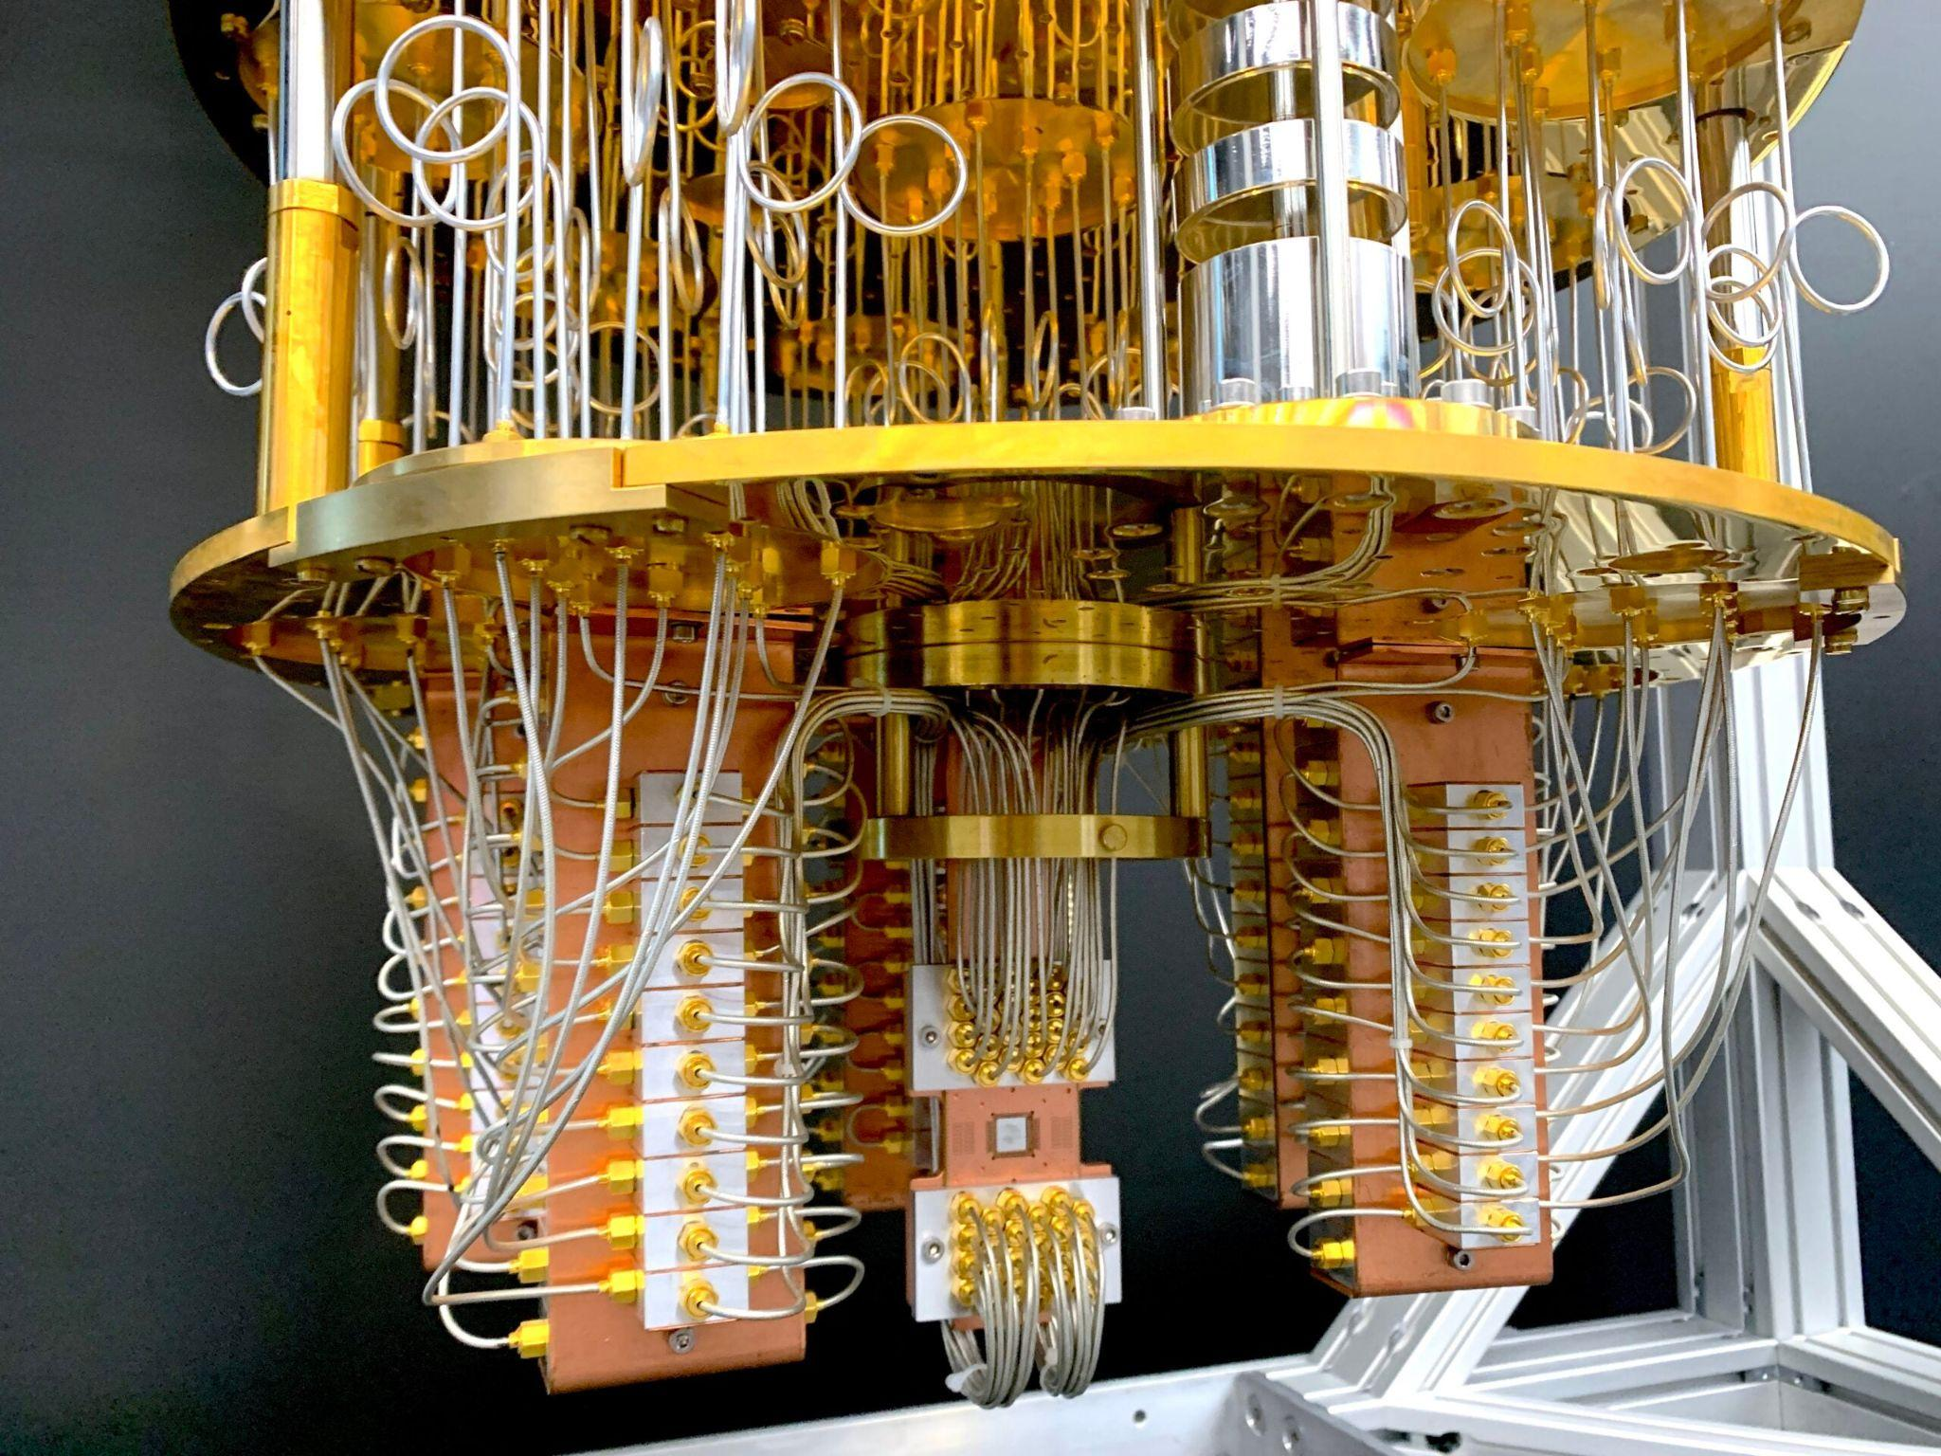

Slide 15
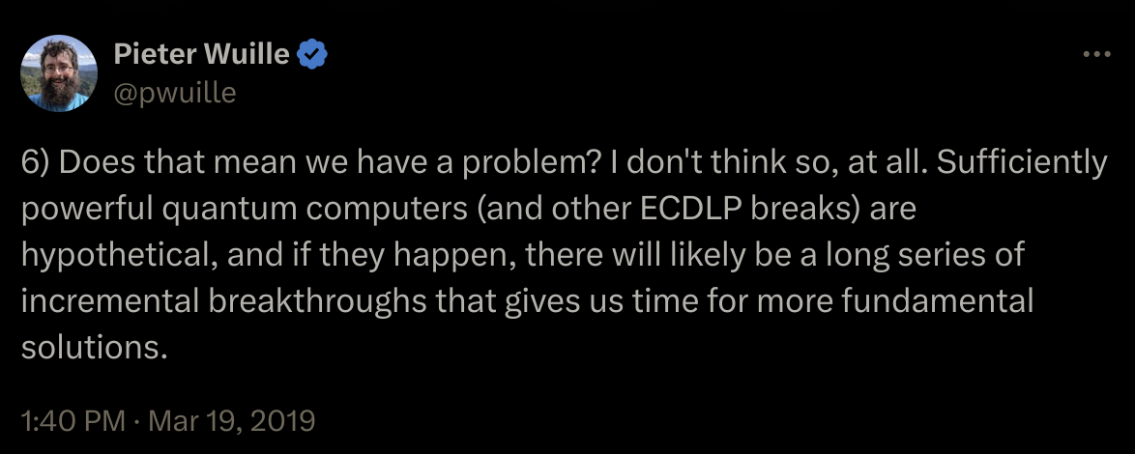
Peter Wuille on Quantum Computing

Slide 16
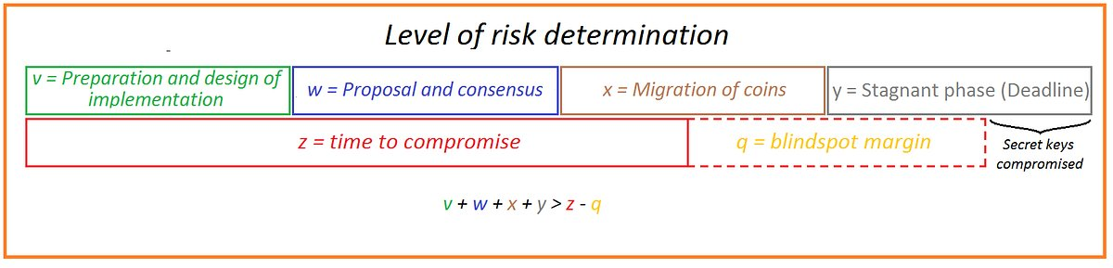
Timeline of Quantum Emergency
Source:
An addition to “Quantum Computing Vs. Blockchain” (IMBA-Exchange)
https://medium.com/@qrcollector/an-addition-to-quantum-computing-vs-blockchain-imba-exchange-2c7229eb5e83

Slide 17
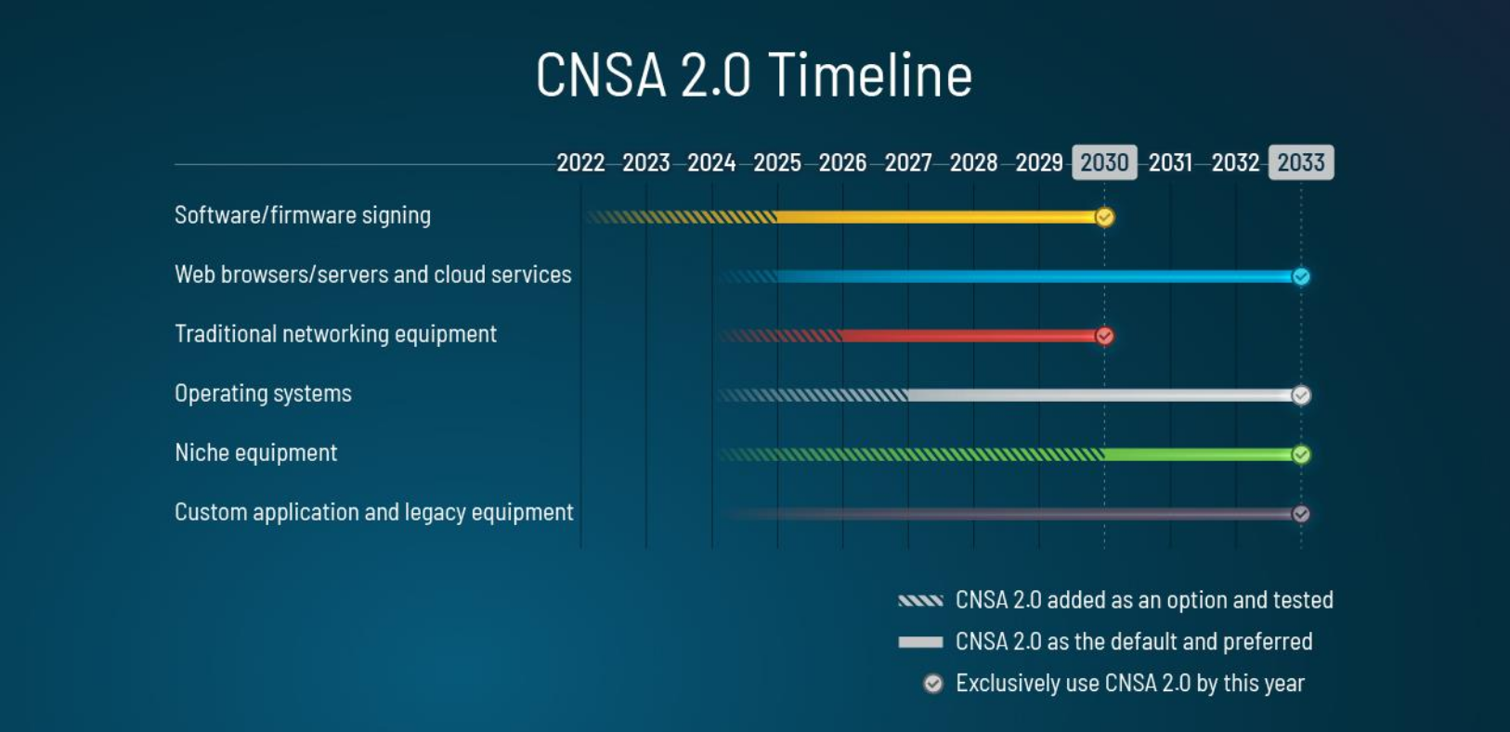
Commercial National Security Algorithm Suite 2.0

Slide 18


Safety of bitcoin held in addresses
Vulnerable
4M
20% is held in old addresses (P2PK) or reused addresses*
Quantum Safe
80% of bitcoin is held in quantum-resistant addresses (P2PKH, P2WPKH)*
15.7M
* Source: Deloitte, “Quantum computers and the Bitcoin blockchain,” 2020

Slide 19
So what do we do
to make Bitcoin quantum secure?

Slide 20
Post-Quantum Cryptography
SQIsign
ECDSA
Public Keys: 128 bytes
Public Key Hash: 32 bytes
Signatures: 335 bytes
SQIsign → Short Quaternion and Isogeny Signature
Public Keys: 33 bytes
Public Key Hash: 20 bytes
Signatures: 70-72 bytes
FALCON (FIPS 206 - FN-DSA)
Schnorr
Public Keys: 1793 bytes
Public Key Hash: 32 bytes
Signatures: 1280 bytes
FALCON → Fast-Fourier Lattice-based Compact Signatures over NTRU
Public Keys: 32 bytes
Signatures: 64 bytes

Slide 21
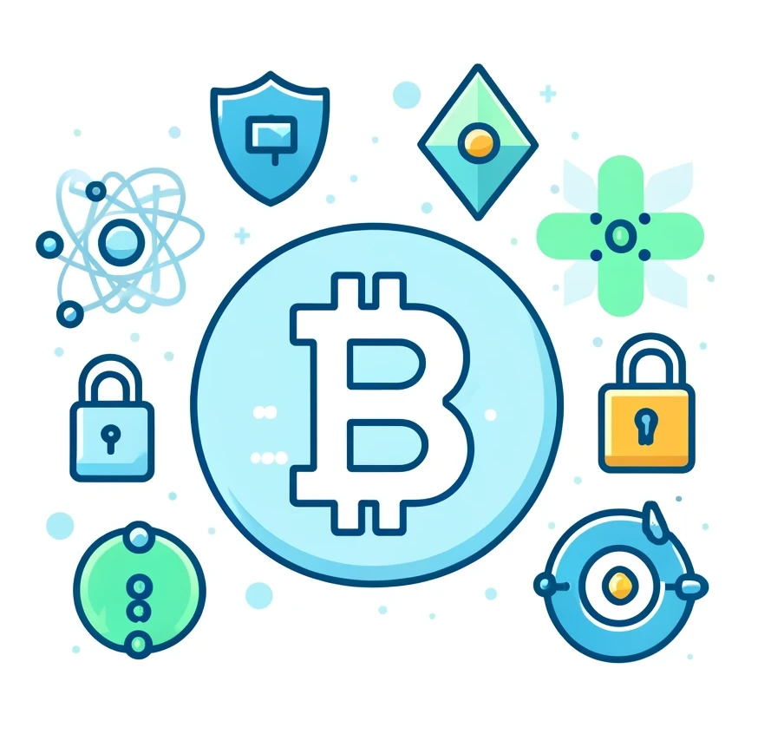
BIPs
01
P2QRH
Quantum Resistant (QR) addresses
02
QuBit Activation
Quantum Resistant Soft Fork
03
P2QS
Quantum Secure (QS) addresses

Slide 22
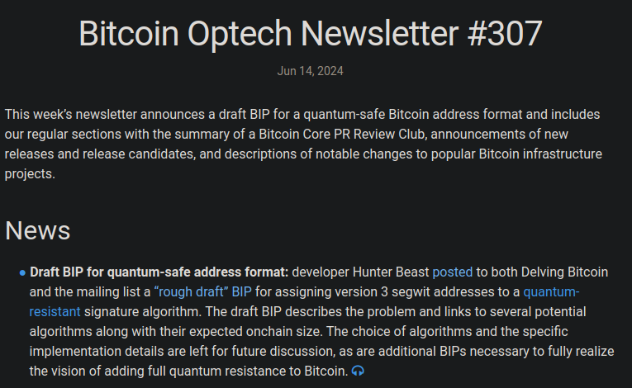

Slide 23
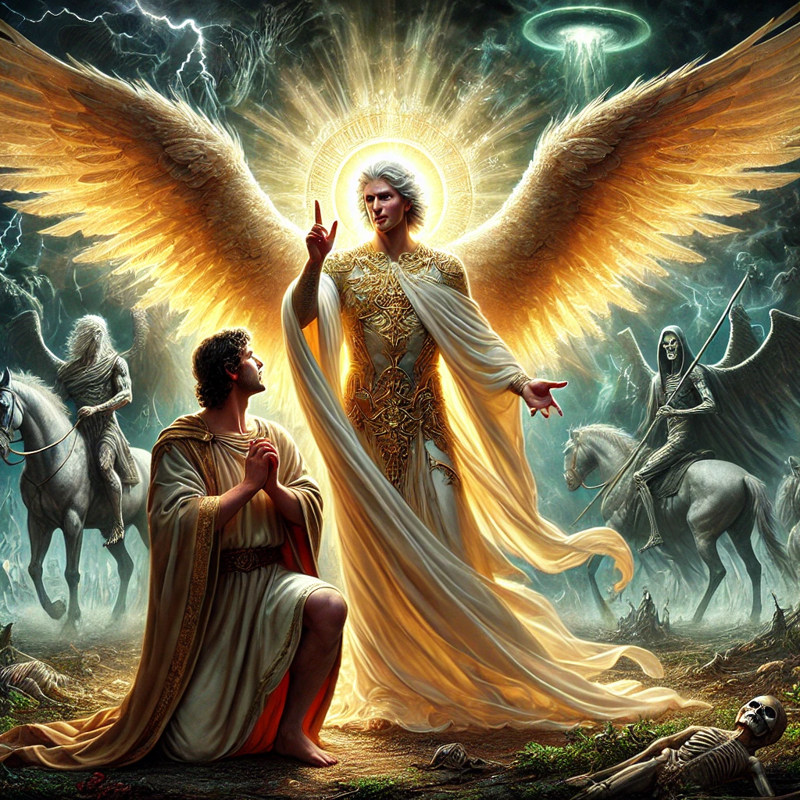
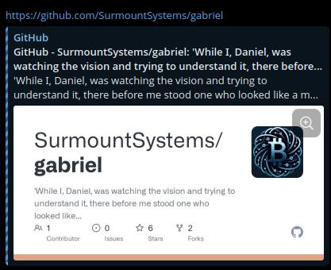
Gabriel
“Satoshi’s Shield” provides a warning and buffer of quantum attacks on bitcoin. The shield consists of the ~1 million P2PK coins in the 1st Epoch. Gabriel will monitor these coins for any movement.

Slide 24
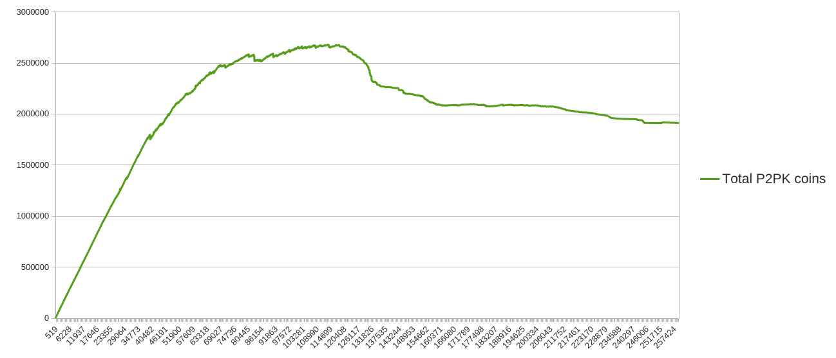
Results

Slide 25
P2QRH
Pay to Quantum Resistant Hash
- 4 new signature algorithms
1. SPHINCS (SLH-DSA)
2. CRYSTALS-Dilithium (ML-DSA)
3. FALCON (FN-DSA)
4. SQIsign (under review)
- Soft Fork
- New Address Type
- Based on Taproot
- Signature/public key pairs
- Attestation
Secp256k1 64 + 32 = 96
SLH-DSA 29792 + 64 = 29856
ML-DSA 4595 + 2592 = 7187
FN-DSA 1280 + 1793 = 3073
SQIsign 335 + 128 = 463

Slide 26
QuBit Soft Fork
A Quantum Bitcoin Security upgrade
- QuBit discount – 16x
- SegWit discount – 4x
Version +
Marker (00) +
Flag (03) +
Input Count + Inputs
Output Count + Outputs
Witness
Attestation
Locktime
Secp256k1 96 / 16x = 6 vb
SLH-DSA 29856 / 16x = 1866
ML-DSA 7187 / 16x = ~449
FN-DSA 3073 / 16x = ~192
SQIsign 463 / 16x = ~29
Examples:
QuBit SQIsign + Schnorr = 35
SegWit 64 / 4x = 16 + 32 = 48

Slide 27
Stakeholders
Who we have to convince
- Individual node runners (UASF)
- Economic node runners (exchanges)
- Enthusiasts
- Investors
- Influencers
- Protocol devs (Core, Knots, Libre Relay, Inquisition, etc…)
- Application devs (services, wallets, layers)
- Miners (Stratum v2, DATUM)
- Mining pools (MASF)

Slide 28
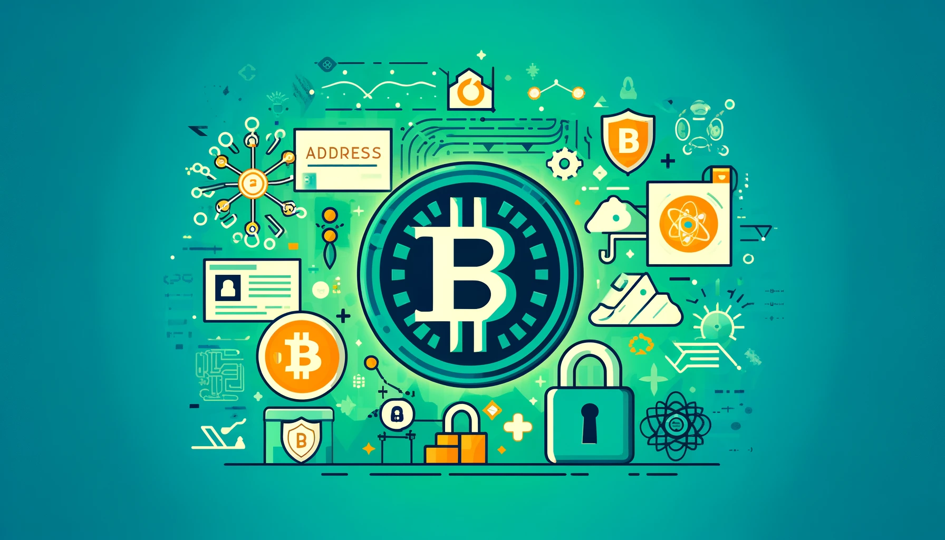
Please check out our work at https://surmount.systems
Also follow us on X: @SurmountSystems

